Slide 1

music analysis
Data Science

Slide 2
The Questions:
Are there any specific characteristics to an album with a high rating?
Can we predict the score of an album based on it’s features?
Can we predict the genre of an album?

Slide 3



Data collected from:
And Spotify
Dataset created by:

Slide 4
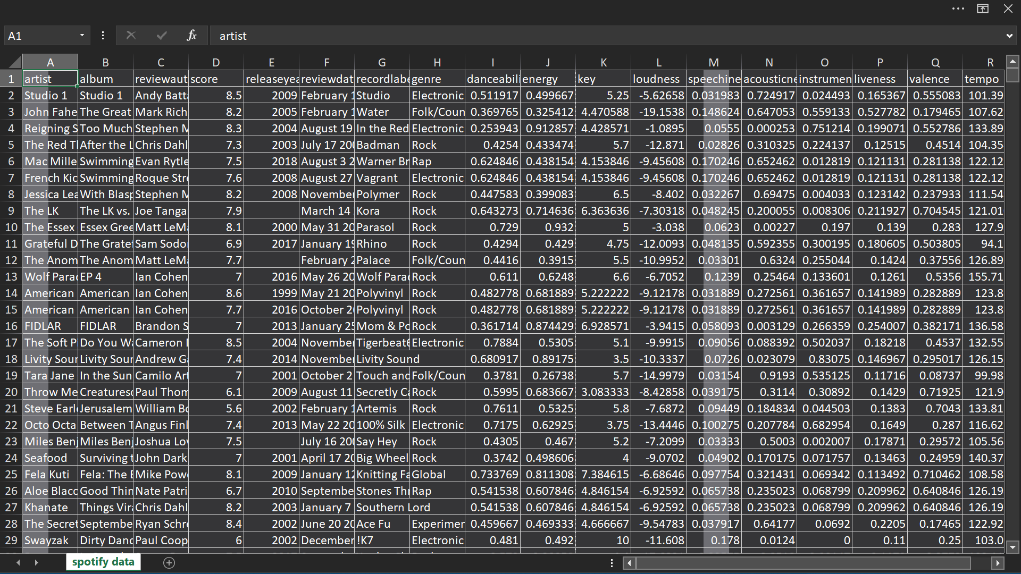
The dataset:

Slide 5
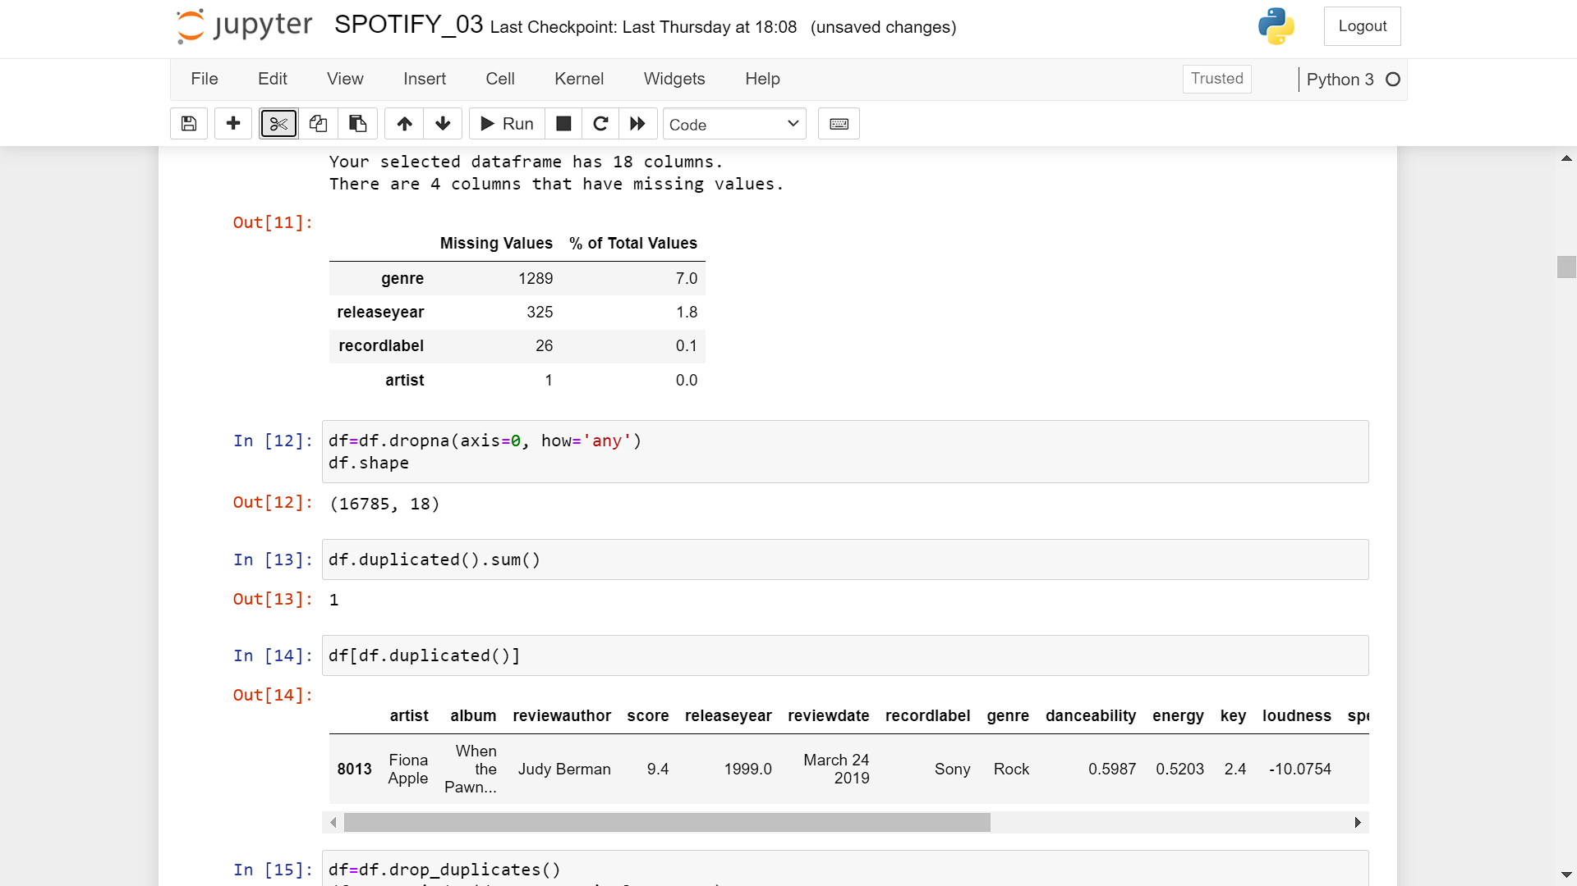
Cleaning the data

Slide 6
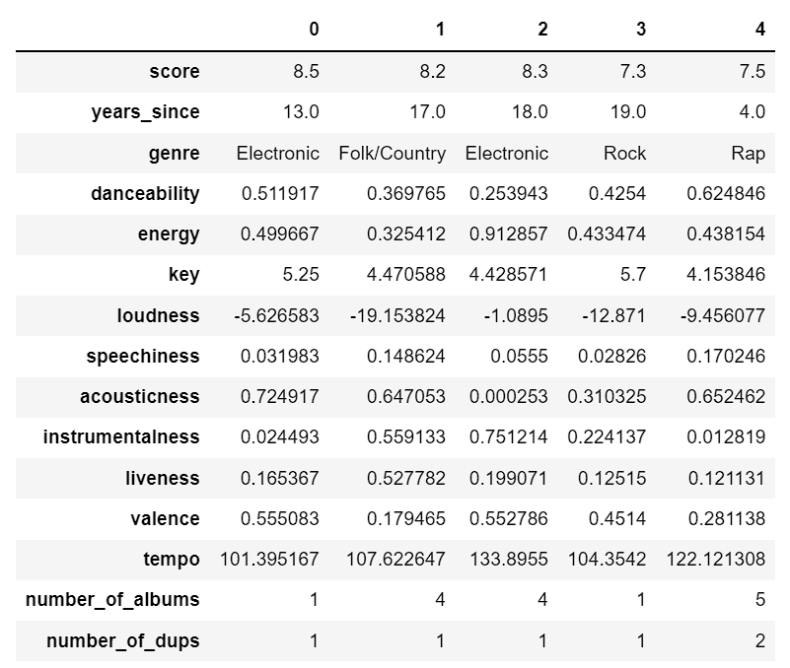
Columns: ‘artist’ and ‘album’ were transferred into numeric features - counting the number of albums released by the same artist and the number of albums that were released more than once
data handling
Columns: ‘releaseyear’ was transferred into ‘years_since’ in order to be compatible with the linear regression later.

Slide 7
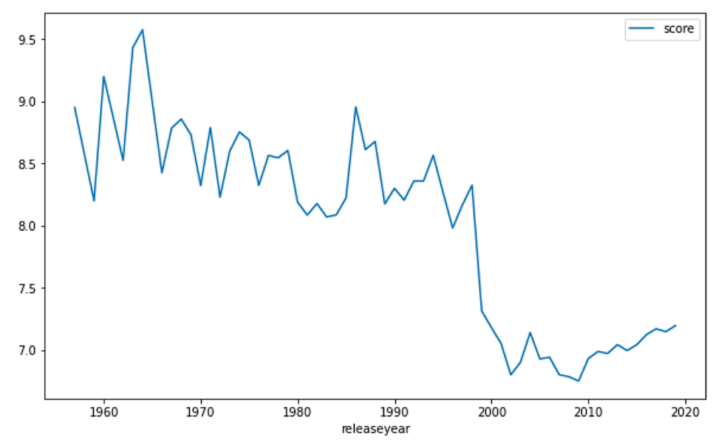
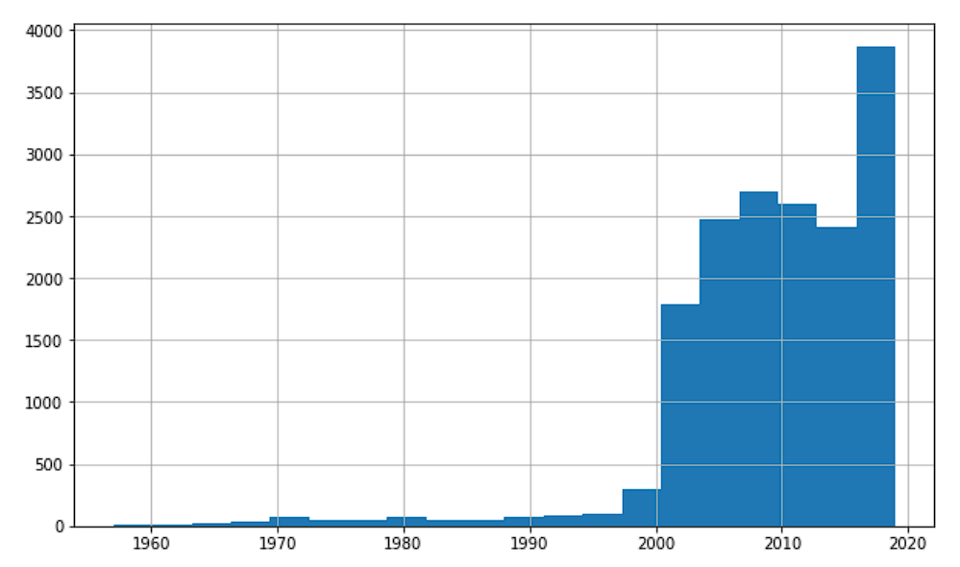
EDA
Release year vs score:
It is clear from the graph that albums released in the 20th century are rated higher than the ones in the past couple of decades.
It is worth mentioning that there are far more new albums in the dataset.

Slide 8
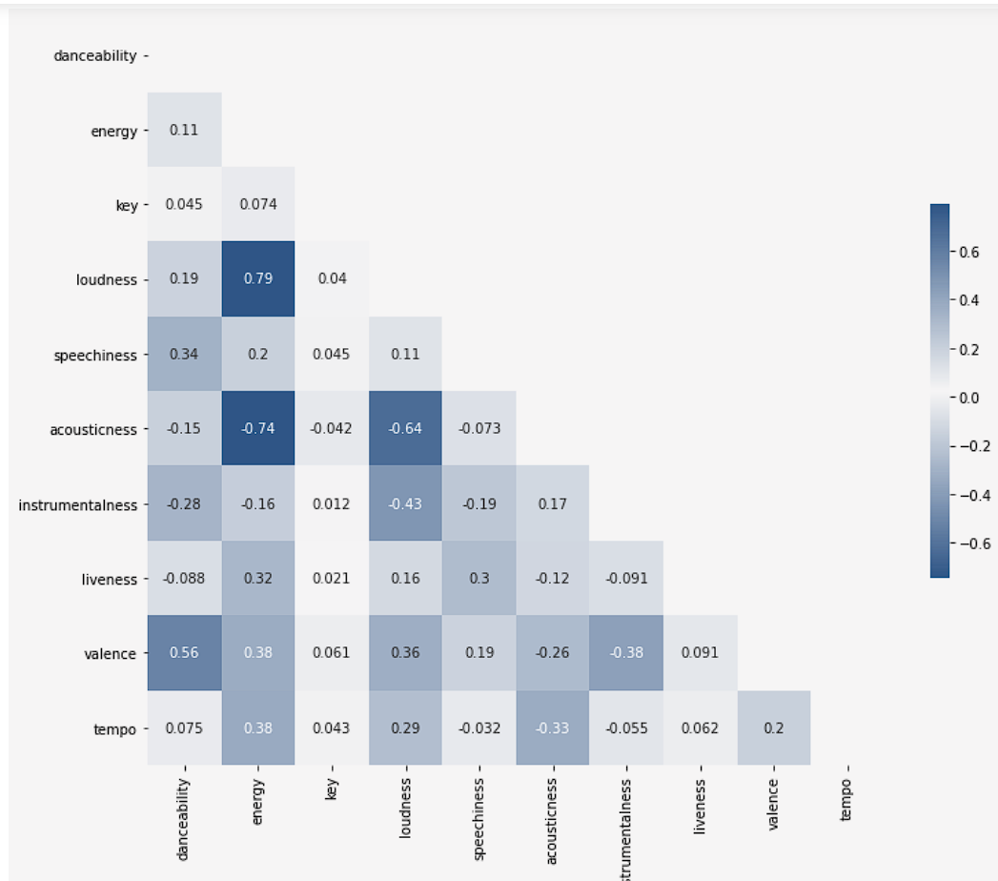
Correlation between numeric attributes
Highest correlated columns are ‘loudness’ and ‘energy’
‘acousticness’ and ‘energy’ also have a high negative correlation between them.

Slide 9
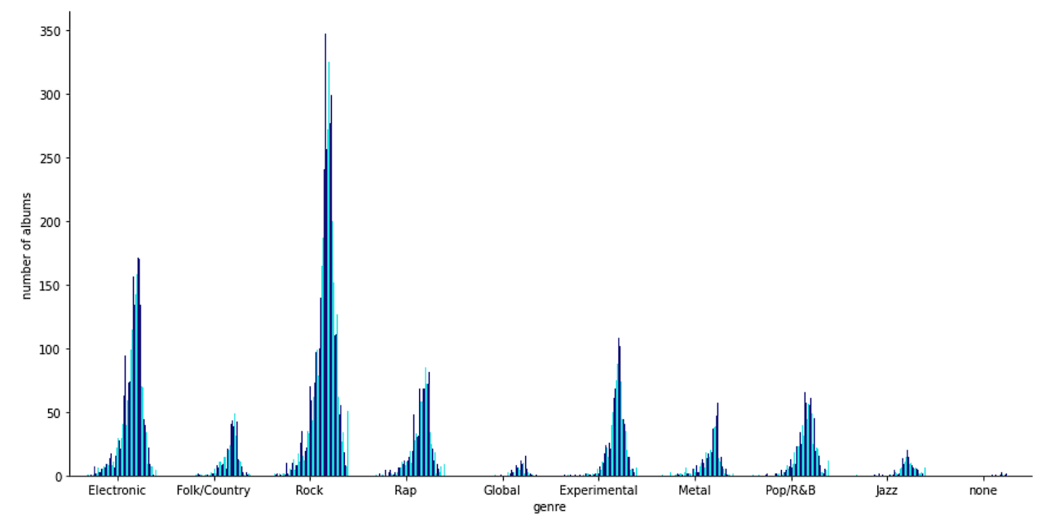
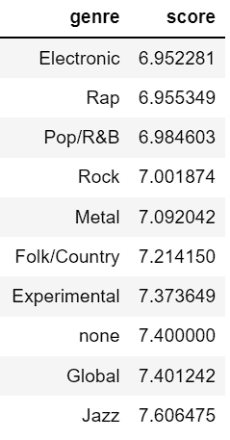
Distribution of score by genres
In this graph we see the distribution of albums' scores by each genre
And we can understand that they’re quite similar.
We can also see the dominance of each genre in the dataset.
Median genre score

Slide 10


Slide 11
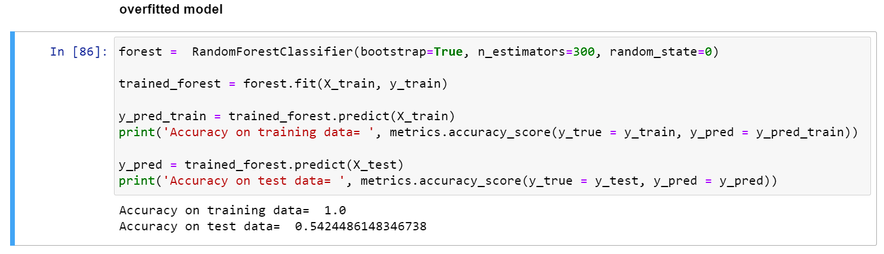
predicting the genre of an album with Random Forest
overfitting
It is clear from the first model that we have a case of overfitting since the accuracy in the training data is: 1.0 while the accuracy on the test data is much lower.
To handle the overfitting, I limited the depth to 8 and the minimum sample leaf to 20

Slide 12
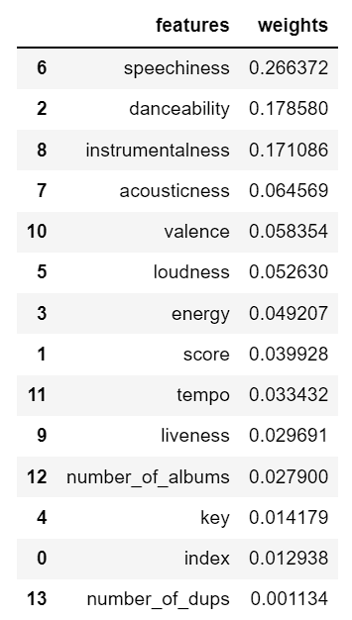
Importance of features
‘speechiness’ is the most important feature when it comes to predicting the genre of an album.
‘danceability’ and ‘instrumentalness’ are the next best estimators in the model.

Slide 13
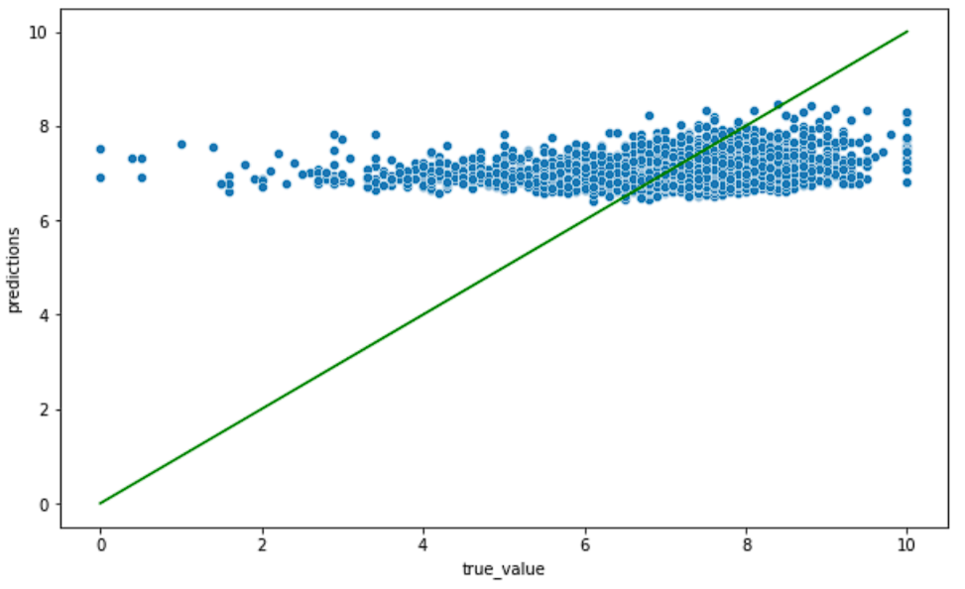
Unfortunately, linear regression could not predict the score of an album given it’s features and characteristics.
Attempting to predict the score of an album using linear regression
This is the result with an R^2 of 0.043.

Slide 14
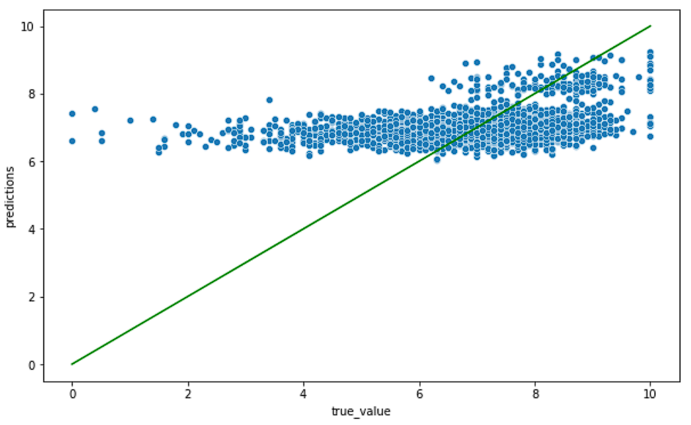
Attempting to predict the score of an album using Random Forest
This is the result with an R^2 of 0.103.
Both linear regression and random forest failed to predict the score of an album, based on the features of this dataset. So a different approach is warranted.

Slide 15
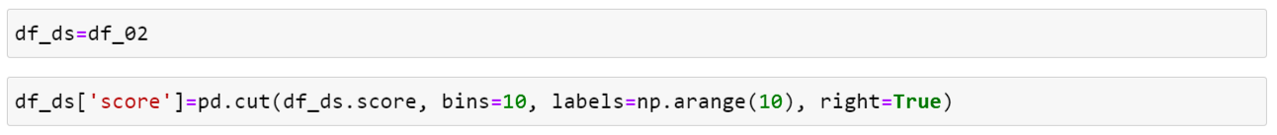
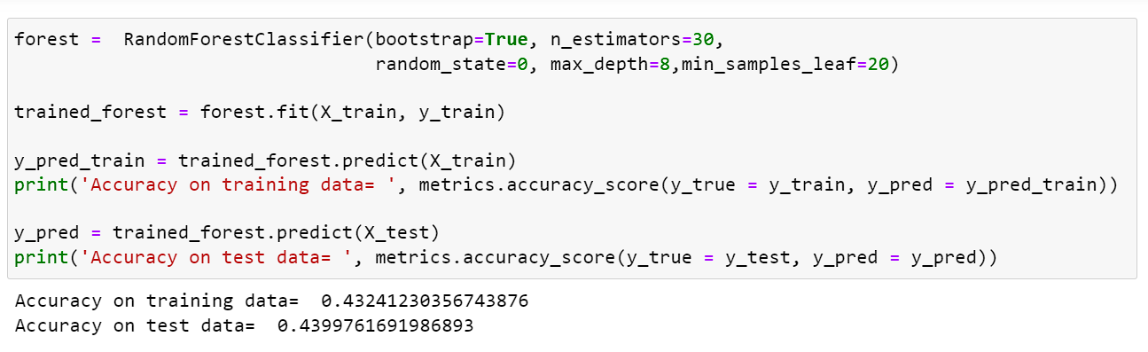
converting the 'score' to discrete variables and trying with random forest
This time we got better result but the accuracy is still too low…

Slide 16
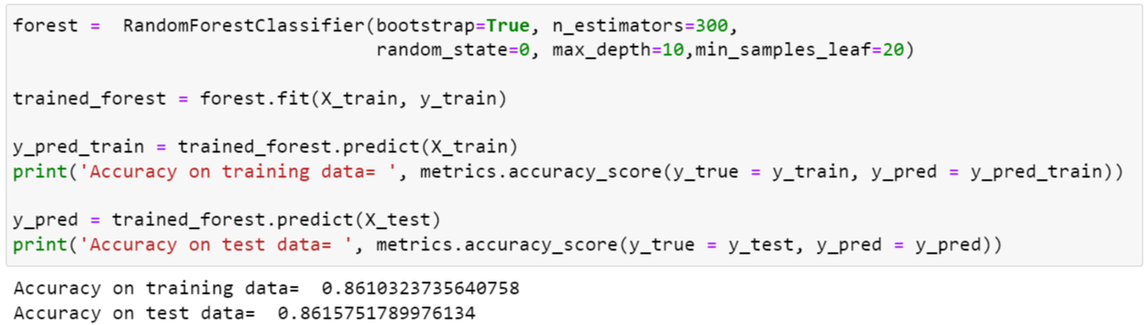
Going binary
So far predicting the exact score of an album was unsuccessful. the next best thing would be switching from ‘score’ to a binary category and to predict which albums are rated ‘good’ (score of 8 and above) and which are rated ‘not good’ (score of 7 or below)
And now we have it!
A model that predicts whether or not an album will be liked by critics with 86% accuracy

Slide 17
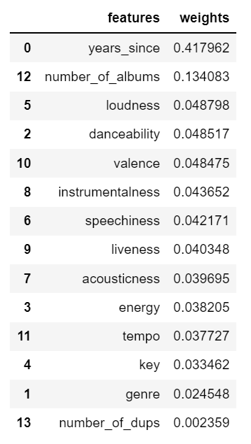
Importance of features
‘years_since’ is the most important feature when it comes to predicting the score of an album.
As assumed genre is not a good indicator in this model since it’s distributing is very similiar

Slide 18
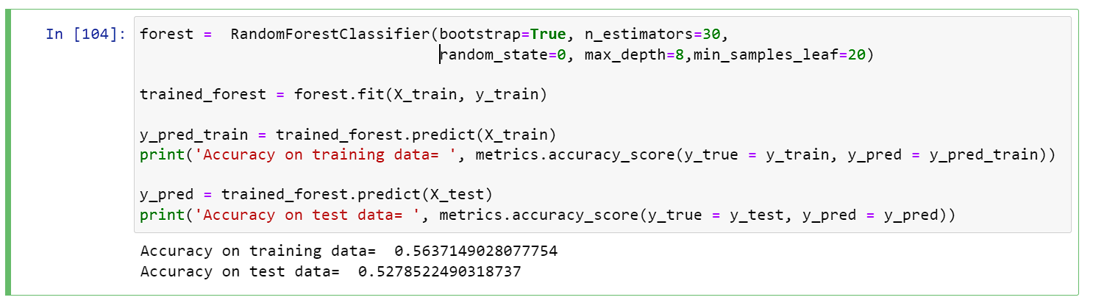
The result of the Random Forest model for predicting genre

Slide 19
conclusion
The technical features of an album aren’t necessarily a good indication to which genre it belongs to.
converting continuous variables to discrete values and changing the method of the model to one of classification can help improve accuracy.
Instead of predicting the exact score of an album, we can predict whether or not an album will be well received by critics.
The most effective estimator on predicting the sentiment toward an album is the time that has passed since it’s release.

